Slide 1
PROJECT TITLE:
DIGITAL PORTFOLIO :
STUDENT NAME: P.DIVESH
REGISTER NO AND NMID: 222407617
DEPARTMENT: BSC COMPUTER SCIENCE
COLLEGE: VEL TECH RANGA SANKU ARTS COLLEGE /UNIVERSITY OF MADRAS

Slide 2


AGENDA :
Problem Statement
Project Overview
End Users
Tools and Technologies
Portfolio design and Layout
Features and Functionality
Results and Screenshots
Conclusion
Github Link
3/21/2024 Annual Review

Slide 3

PROBLEM STATEMENT
IN TODAYS DIGITAL ERA, TRADITIONAL RESUMES ARE NOT ENOUGH TO EFFECTIVELY SKILLS AND PROJECTS.
MANY STUDENTS AND PROFESSIONALS LACK A STRUCTURED ONLINE PRESENCE TO HIGHLIGHT THEIR WORK AND ACHIEVEMENTS

Slide 4

PROJECT OVERVIEW
BRIEF SUMMARY : THIS PROJECT IS A DIGITAL PORTFOLIO TO PROFESSIONALLY PRESENT MY BACKGROUND,SKILLS, AND CREATIVE WORK.
KEY SECTION : ABOUT ME , PROJECTS ,SKILLS , AND CONTACT FOR EASY NAVIGATION.
MAIN IDEAS : SHOWCASE PERSONAL ACHEIVEMENTS, HIGHLIGHT TECHNICAL EXPERTISE, AND DISPLAY COMPLETED PROJECTS IN AN ORGANIZED MANNER.

Slide 5

WHO ARE THE END USERS?
STUDENTS : SHOWCASE ACADEMIC PROJECTS,ASSIGNMENTS AND BUILD RESUMES FOR FUTHURE STUDIES.
JOB SEEKERS: SHARE SKILLS , EXPERIENCE AND PORTFOLIO WITH RECRUITERS AND EMPLOYERS.
FREELANCERS: PRESENT WORK SAMPLES AND COMPLETED PROJECTS TO ATTRACT POTENTIAL CLIENTS.

Slide 6

TOOLS AND TECHNIQUES
HTML : BUILDS THE MAIN STRUCTURE OF ALL PORTFOLIO PAGES AND SECTION
CSS : STYLES THE PORTFOLIO WITH COLORS,LAYOUTS AND MAKES IT RESPONSIVE FOR ALL DEVICE SIZES.
JAVASCRIPTS : ADDS INTERACTIVITY-NAVIGATION MENU , ANIMATIONS AND FORM VALIDATION.

Slide 7
POTFOLIO DESIGN AND LAYOUT
ORGANIZED SECTION :
HOME/ABOUT ME, PROJECTS,SKILLS , CONTACT.
CONSISTENT COLOR SCHEME AND CLEAN TYPOGRAPHY THROUGHTOUT THE PORTFOLIO.
EASY NAVIGATION BAR FOR SMOOTH MOVEMENT BETWEEN SECTION.
FULLY RESPONSIVE LAYOUT OPTIMIZED FOR BOTH MOBILE AND DESKTOP DEVICES.
7

Slide 8
FEATURES AND FUNCTIONALITY
NAVIGATION BAR WITH SMOOTH SCROLLING FOR EASY ACCESS T ALL SECTIONS.
PROJECT SHOWCASE INCLUDING IMAGES AND DETAILED DESCRIPTIONS FOR EACH PROJECT.
RESPONSIVE DESIGN THAT WORK SEAMLESSLY ON DESKTOP,TABLET AND MOBILE DEVICES.

Slide 9
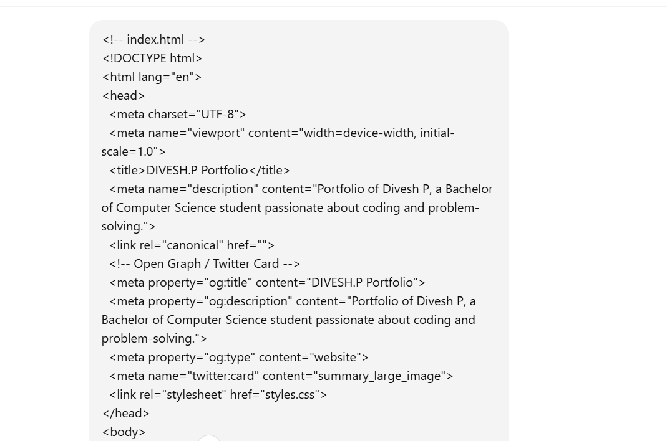
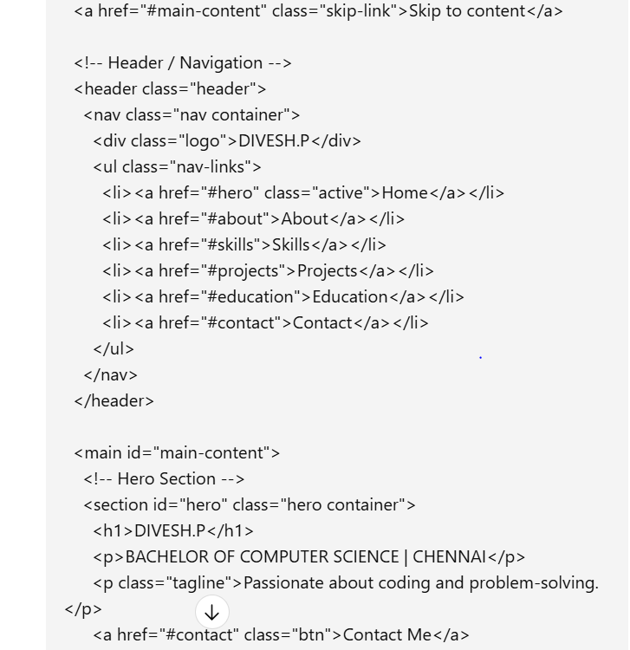
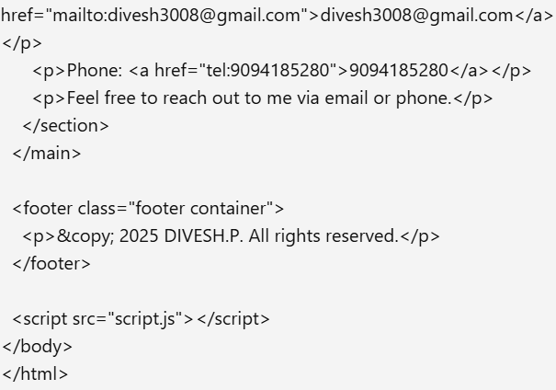
RESULTS AND SCREENSHOTS
3/21/2024 Annual Review
9

Slide 10
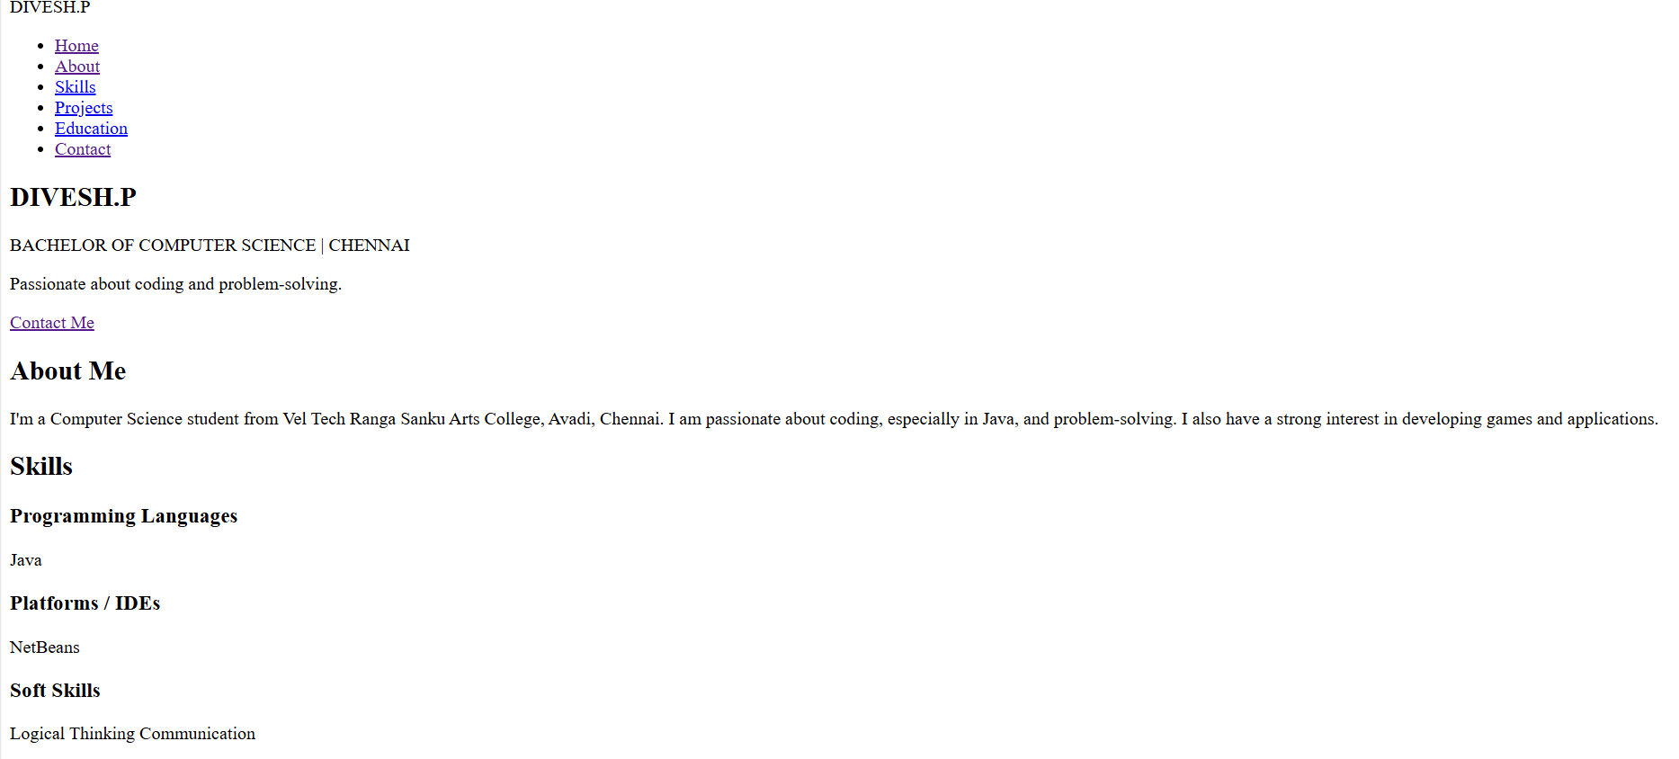
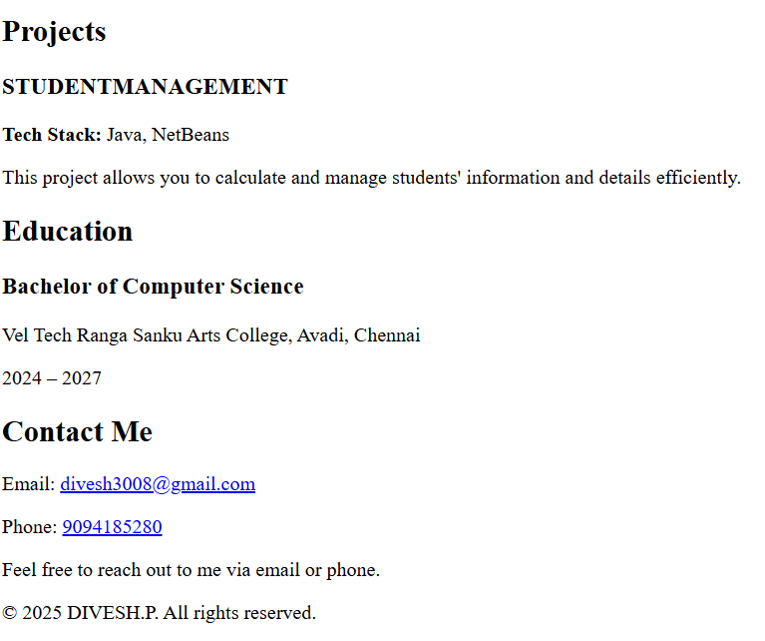
10

Slide 11
CONCLUSION
BUILT A MODERN DIGITAL PORTFOLIO FOR SHOWCASING PORTFOLIO.
HELPS IN CAREER OPPORTUNITIES AND ACADEMIC SHOWCASES .

